Slide 1
At the end of this session, Students will be able to write menu Driven programs to perform operations on Classes
Menu Driven Programs
Session 17, 18
Session Outcome:
KLEF OOPS BES-1

Slide 2
Contents
Multi-way selection
Infinite loop
Template: Menu Driven program in java
Menu Driven Programs
Simple Menu Driven Program in java
Menu Driven Program to Add and display Student Details
KLEF OOPS BES-1

Slide 3
Multi-way Selection using ‘switch’ statement
A switch statement may be used when
only one variable is being checked in each condition
the check involves specific values of that variable
(e.g. 'A', 'B') and not ranges (e.g. >39 ) ;
KLEF OOPS BES-1

Slide 4
The ‘switch’ statement: an example in java
char group;
System.out.println("Enter your group (A,B,C)");
group = sc.next().charAt(0);
switch(group)
{
case 'A': System.out.print("10.00 a.m ");
break;
case 'B': System.out.print("1.00 p.m ");
break;
case 'C': System.out.print("11.00 a.m ");
break;
default: System.out.print("No such group");
}
KLEF OOPS BES-1

Slide 5
Infinite loop
An infinte loop is a loop that will execute indefinitely because the loop's expression is always true
Syntax:
while(true)
{
….
statements to be repeated;
break;
}
Make sure you there is break; statement of System.exit(0); inside the body of the loop.
These statements will let you come out of the loop. Otherwise, the loop will execute indefinitely.
KLEF OOPS BES-1

Slide 6
Template : menu driven program using infinite loops:
public static void main(String[] args)
{
Scanner scan = new Scanner(System.in); System.out.println("::Welcome to Menu driven code::");
while(true)
{
System.out.println("To execute case 1, Enter value 1"); System.out.println("To execute case 2, Enter value 2");
System.out.println("To Exit, Enter value 9"); System.out.println("Enter your choice::");
int choice = scan.nextInt();
switch(choice)
{
case 1: System.out.println("I am case 1");
break;
case 2: System.out.println("I am case 2");
break;
case 9: System.out.println("Exiting the application");
System.exit(0);
default: System.out.println("Incorrect input!!! Please re-enter"); }
}
}
KLEF OOPS BES-1

Slide 7
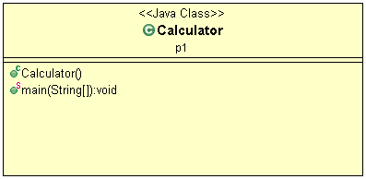
Write a Menu Driven calculator program that performs addition, subtraction, multiplication and division based on the user input
Class Diagram of Calculator class in package p1
is as shown below
KLEF OOPS BES-1

Slide 8
Calculator Program-pseudo Code
switch (operator)
{
case '+':
result = first + second;
break;
case '-':
result = first - second;
break;
case '*':
result = first * second;
break;
case '/':
result = first / second;
break;
case '#':
System.exit(0);
// operator doesn't match any case constant (+, -, *, /)
default:
System.out.printf("operator is not correct");
return;
}
KLEF OOPS BES-1

Slide 9
Sample Output
Enter two numbers: 2
3
Enter (+, -, *, /): or # to exit +
2.0 + 3.0 = 5.0
Enter two numbers: 4
5
Enter (+, -, *, /): or # to exit -
4.0 - 5.0 = -1.0
Enter two numbers: 27
3
Enter (+, -, *, /): or # to exit &
operator is not correct
KLEF OOPS BES-1

Slide 10
Menu Driven Programs
These are programs that display a menu (or list of options), and allows the user to choose what to do.
Normally each menu option calls a different module or method within the program.
This makes the development of the programs a lot easier, since we can develop each module separately.
KLEF OOPS BES-1

Slide 11
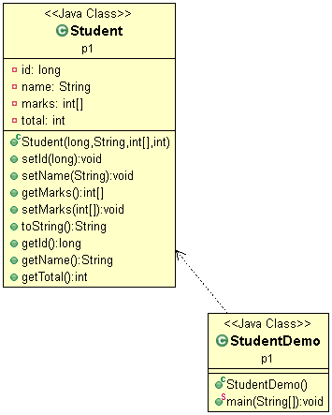
Q) Develop a student class with the following fields: ID, name, marks of 6 subjects(array) as a private instance member and corresponding mutator and accessors and toString() method.
Write a Menu Driven Java Program to
Add a new student and
Display all Student Details.
The class diagram is as follows
KLEF OOPS BES-1

Slide 12
Sample Output:
Press 1 for Add New Student 2 for Print details of all students 3 for Exit
1
enter id, name
1
sarvani
enter marks of subject 0 50
enter marks of subject 1 49
enter marks of subject 2 45
enter marks of subject 3 40
enter marks of subject 4 50
enter marks of subject 5 50
Press 1 for Add New Student 2 for Print details of all students 3 for Exit
2
Student [id=1, name=sarvani, marks=[50, 49, 45, 40, 50, 50], total=284]
Press 1 for Add New Student 2 for Print details of all students 3 for Exit
3
Exiting the application
KLEF OOPS BES-1

Slide 13
Q) Enhance the main () method of Demo class to display a menu of operations as follows:
1. Add new Student
2. Print details of all students
3. Search a student based on ID
4. Search based on name
5. Modify name based on ID
6. Sort based on ID
7. Sort based on total
8. Exit
The program must store details of 10 students
KLEF OOPS BES-1

Slide 14
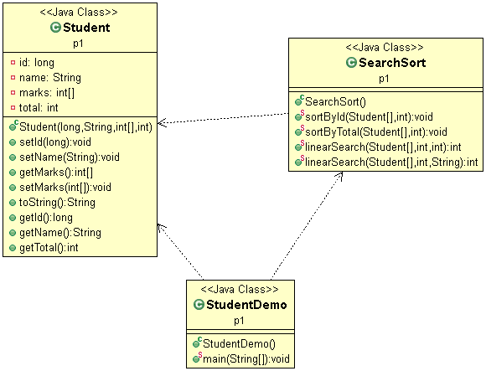
Class Diagram
KLEF OOPS BES-1

